Slide 1

CMR TECHNICAL CAMPUS Accredited by NBA, Approved by AICTE, affiliated to JNTUH Kandlakoya (V), Medchal Road, Hyderabad -501401
Car-e-Takr
Under the guidance
Assistant Professor
V NARESH KUMAR GROUP NAMES
SATYAM SRIVASTAVA(187R1A0515)
HIMANSHU KUMAR(187R1A0521)
DEPARTMENT OF COMPUTER SCIENCE AND ENGINEERING

Slide 2
Content
Abstract
Existing System
Disadvantages
Proposed System
Advantages
Hardware Requirements
Software Requirements
Architecture
Modules
Class Diagram
Use Case Diagram
Sequence Diagram
Dataflow Diagram
Conclusion
Sample code

Slide 3
ABSTRACT
Car(e)Takr is an application designed for every wheelman looking towards an unblemished car.
Car(e)Takr at first hand connects a user to a mechanic without the need of an interceder.
This system in itself is pristine and uses concomitant technologies.
This application uses your current location and shows all the mechanics near your area related to the specific faults.
Car(e)Takr also helps you to identify the probable fault in your car.

Slide 4
EXISTING SYSTEM:
The car repair industry is mostly dependent on people’s interactions.
The mechanic still has to physically check a vehicle for faults.
If the car breaks down, the user has to wait for the mechanic to arrive with the correct tools.
Most of the time users are not able to identify the actual problem of their vehicle.

Slide 5
DISADVANTAGES
Due to manual system it is time consuming process.
Needs manual inspection.
Non Specialized mechanics may lead to inappropriate servicing of the vehicles.
Online mode of payment may not be available.
To avoid all these limitations and make the working more accurately the system needs to be computerized.

Slide 6
PROPOSED SYSTEM
Car(e)Takr provides customers with direct access to the nearest available mechanic.
It gives the relevant details of the assigned mechanic to the customer.
It allows customers to communicate with the assigned mechanic.
It allows customers to request a service and cancel the service request.

Slide 7
ADVANTAGES
It helps the user to identify the fault in their vehicle.
It connects with the relevant mechanic specified to your fault.
Freedom of choice to the user.
Bill will be provided to the upon successful completion of payment.
Password protection for security purposes.

Slide 8
HARDWARE REQUIREMENTS
For developing the application, the following are the Hardware Requirements:
System : Intel Atom Processor Z250 or later
Storage : Between 850Mb and 1.2GB
Ram : 2GB or more
Hard Disk : 2GB of available space for installation

Slide 9
SOFTWARE REQUIREMENTS
Operating system : Windows 7 or later
Front End : XML
Back End : Google Firebase(NoSQL),Java, SQLite
Tool : Android Studio (Platform)

Slide 10
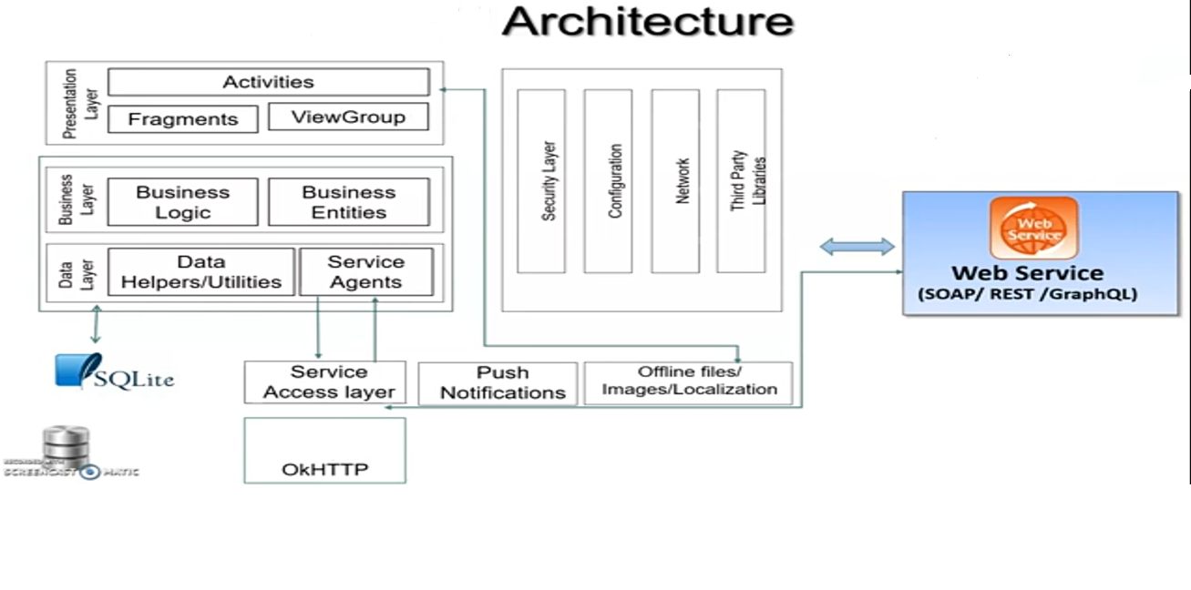
Architecture

Slide 11
Modules
Various modules involve in this project are:
Users
Mechanic
Garage

Slide 12
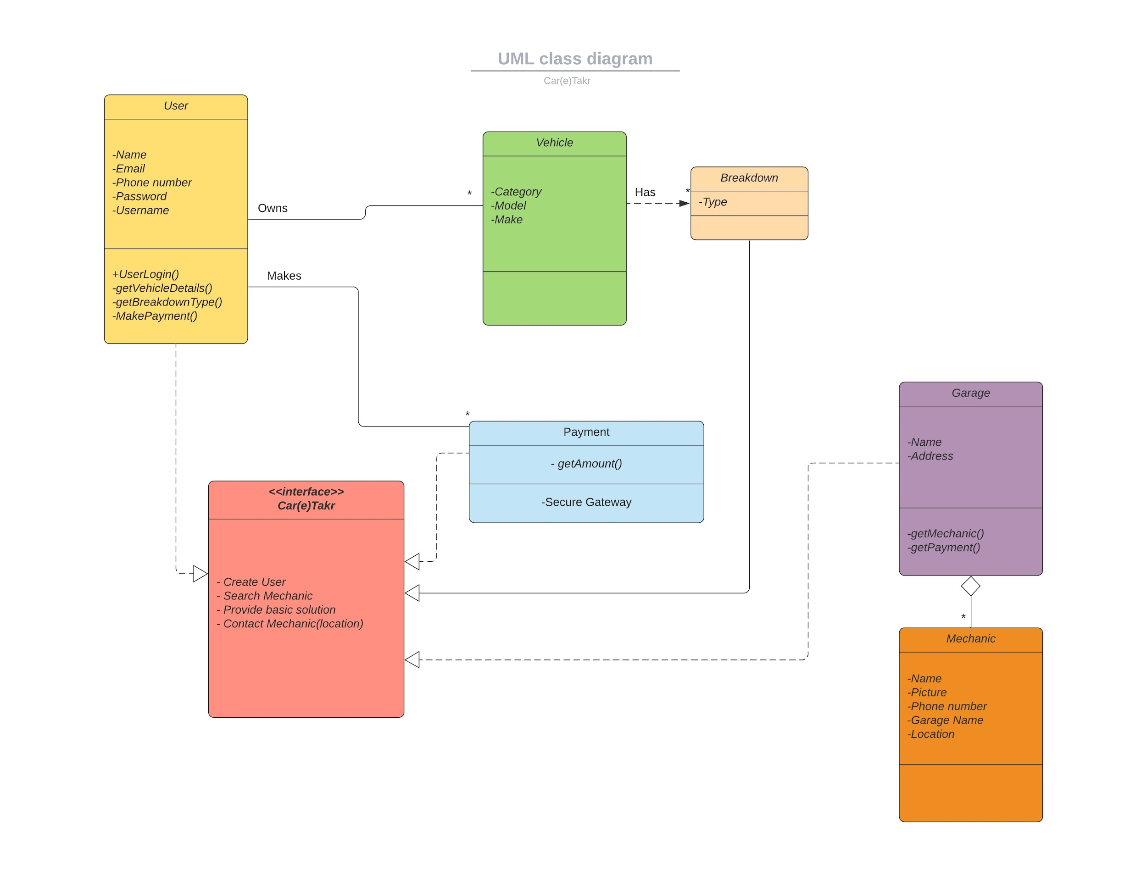
Class diagram

Slide 13
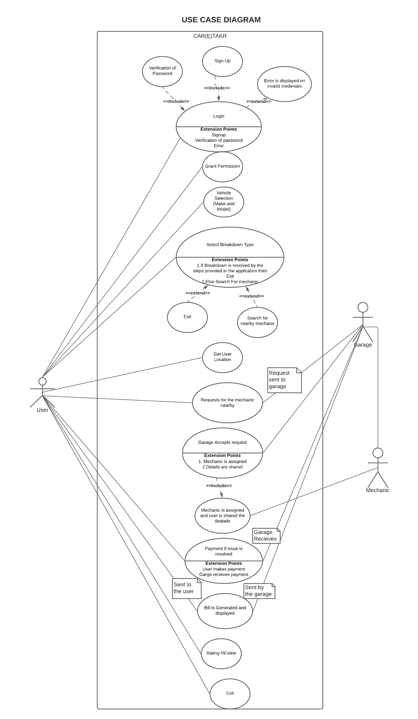
USE CASE Diagram

Slide 14
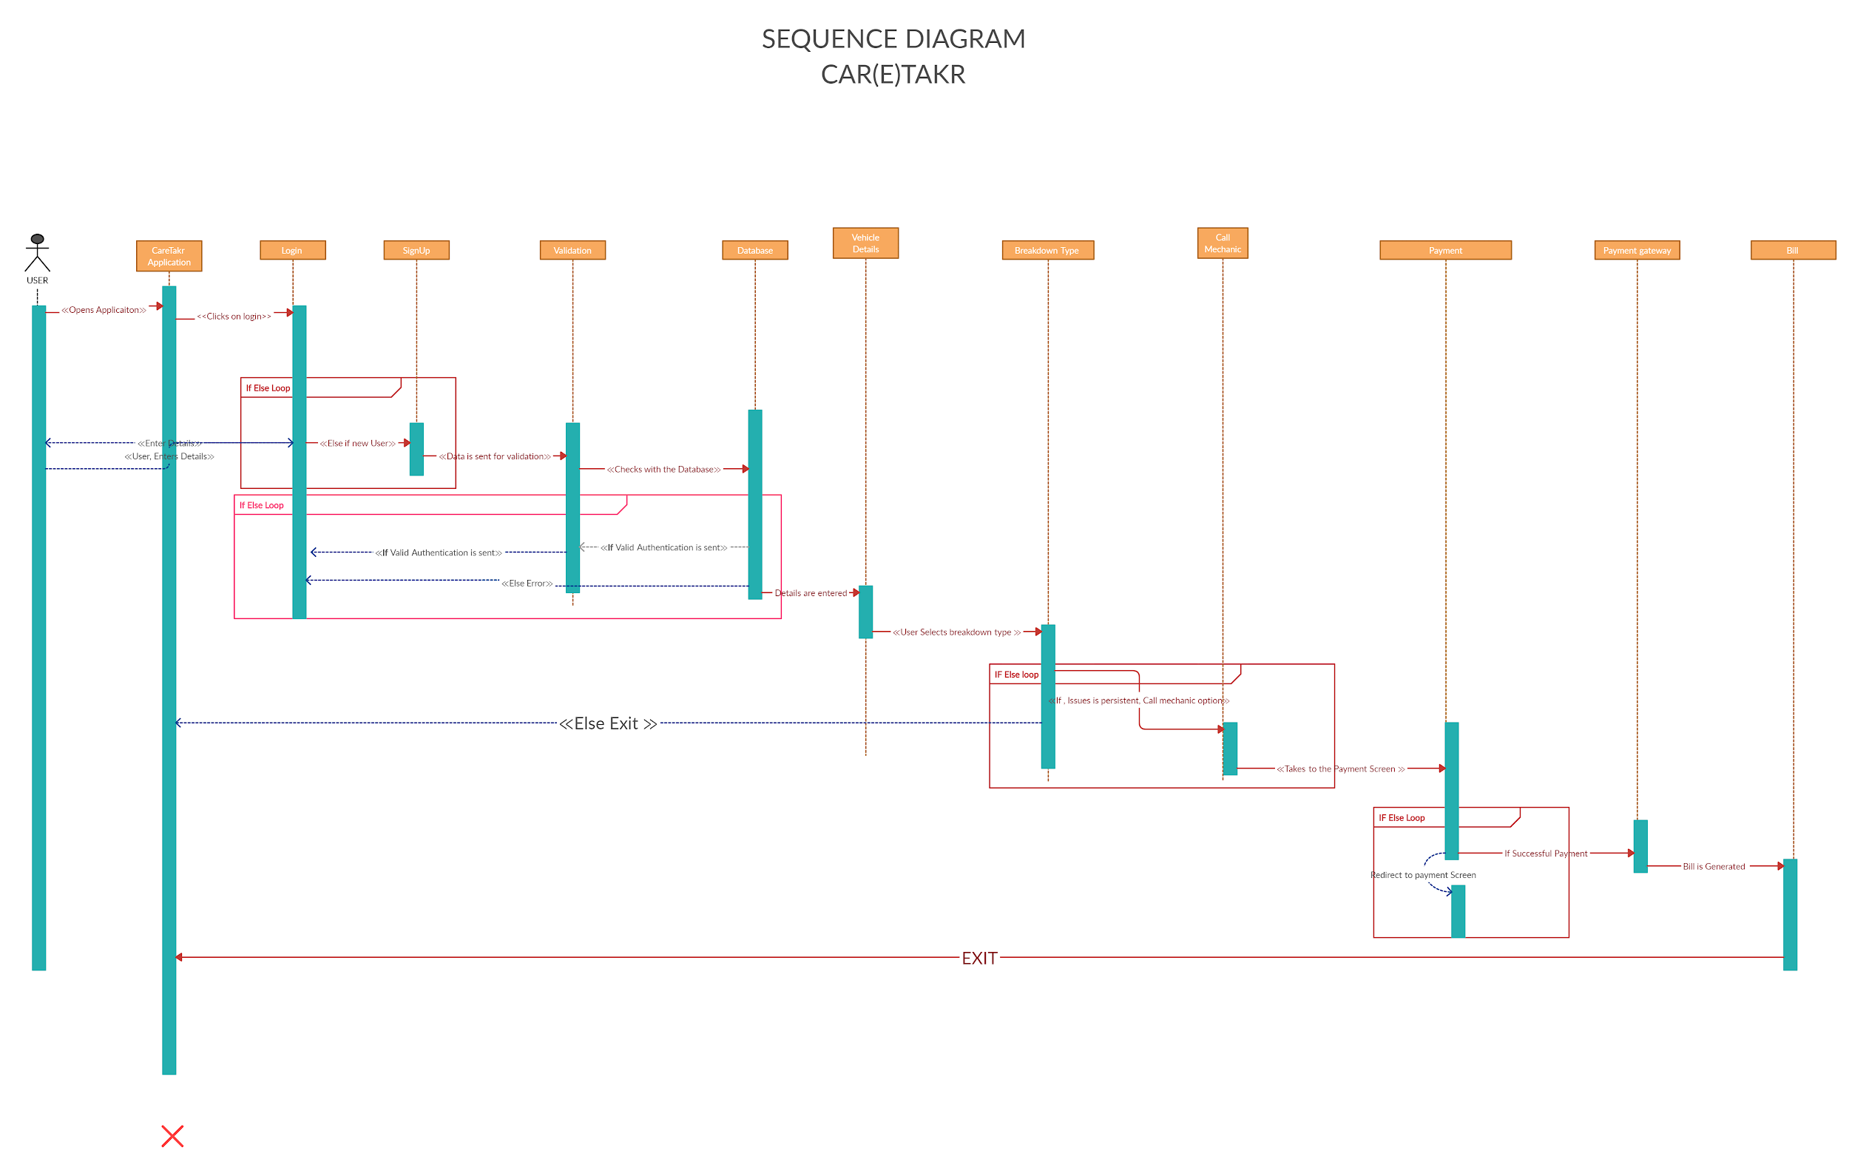
Sequence diagram

Slide 15
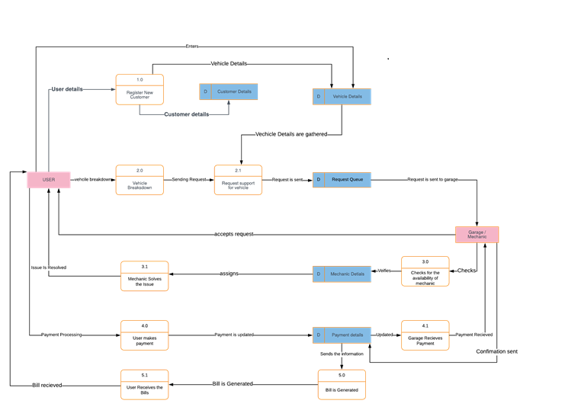
DATA FLOW DIAGRAM

Slide 16
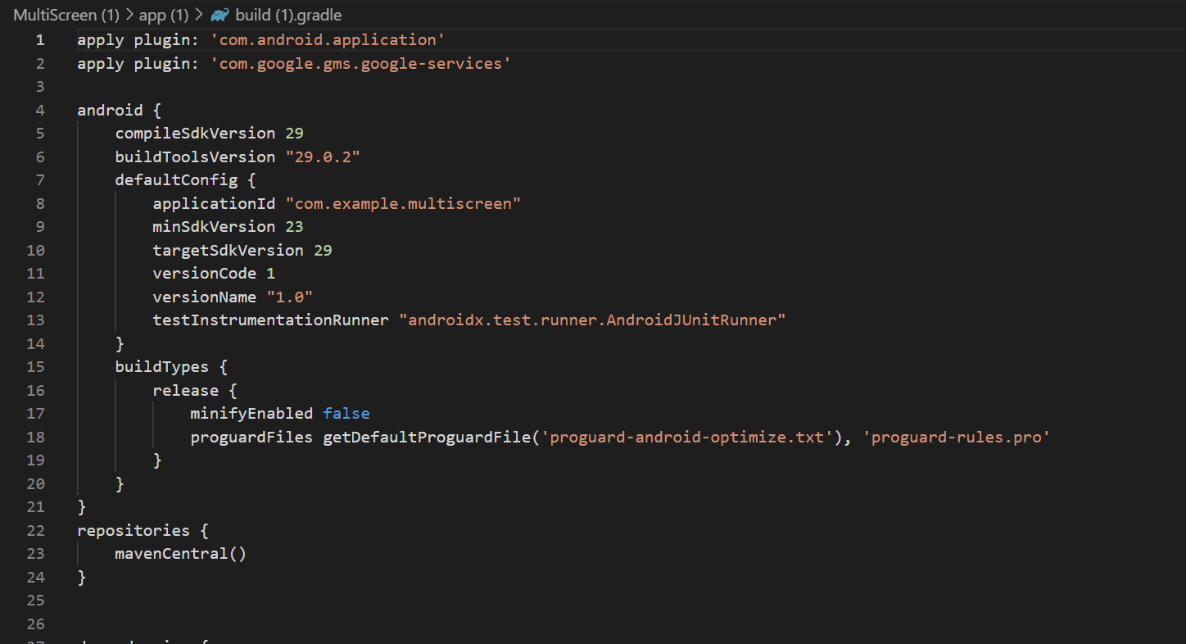
SAMPLE COdE

Slide 17
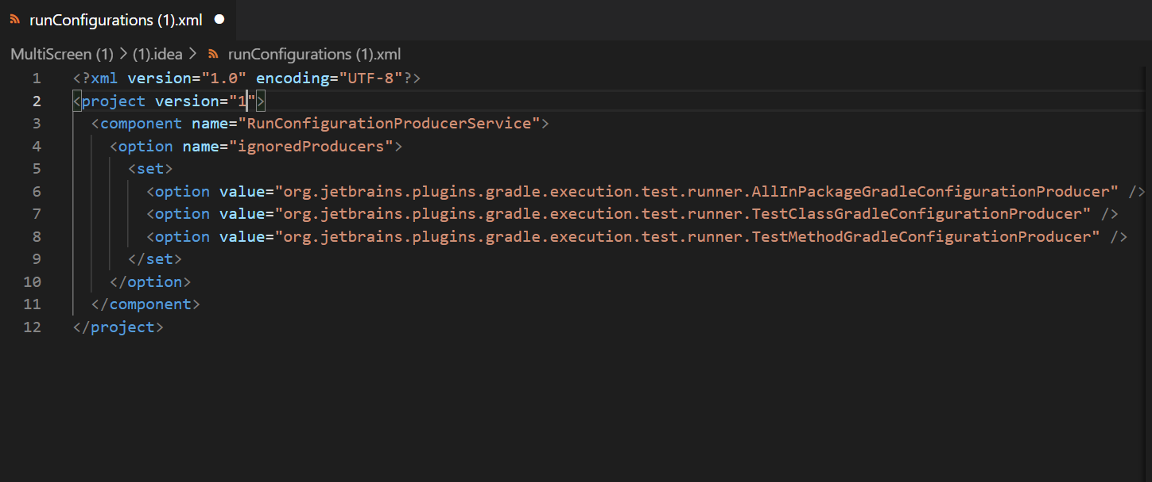
SAMPLE CODE

Slide 18
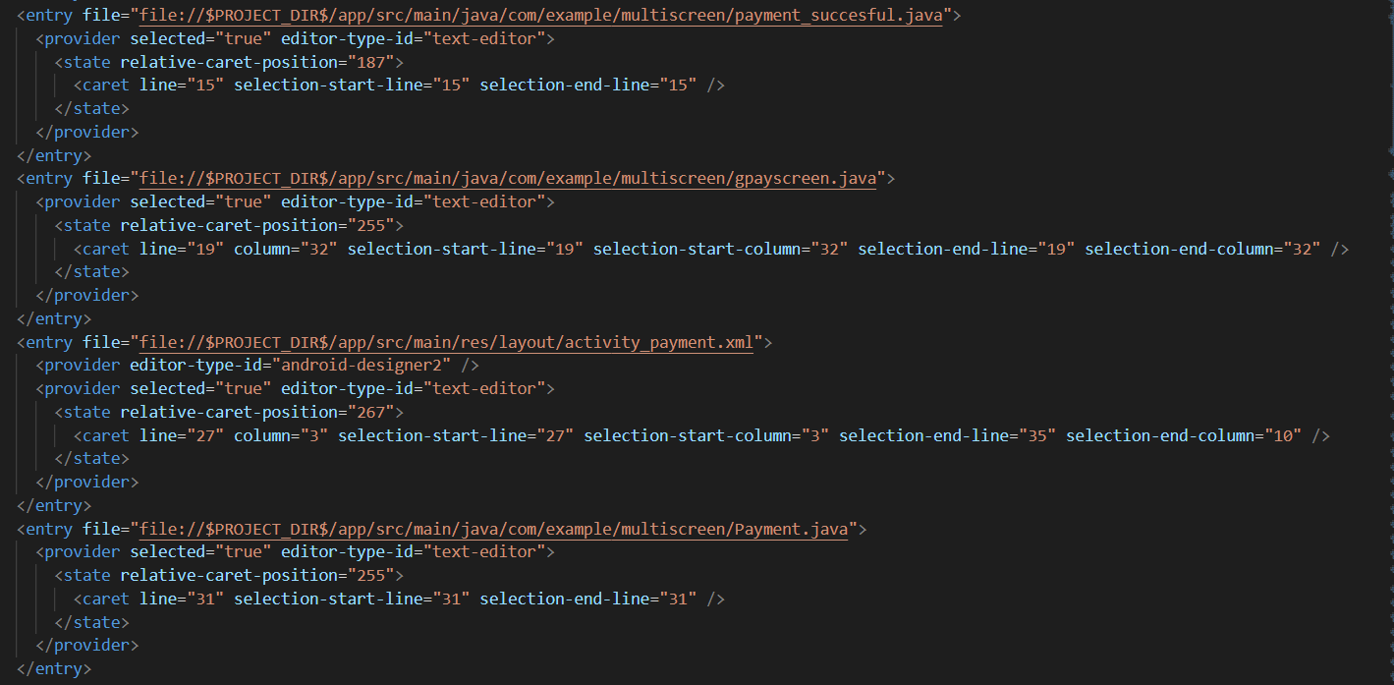
SaMPLE CODe

Slide 19
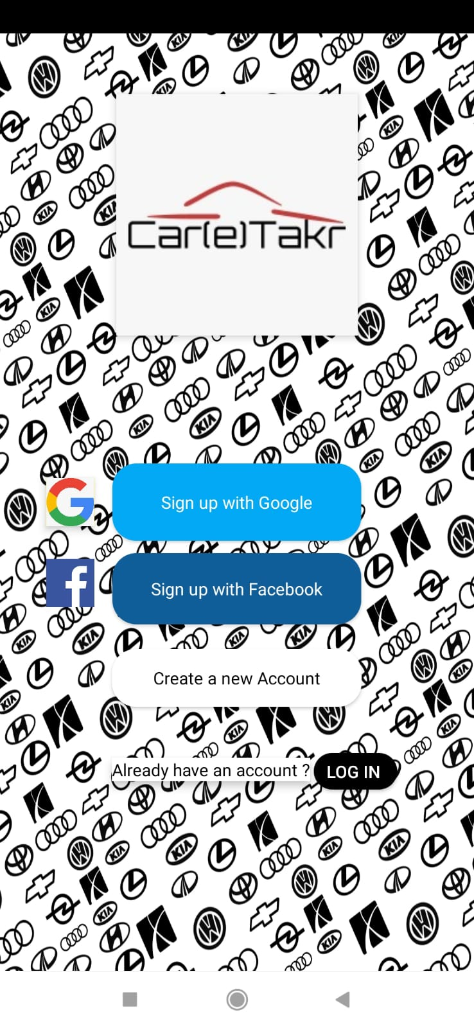
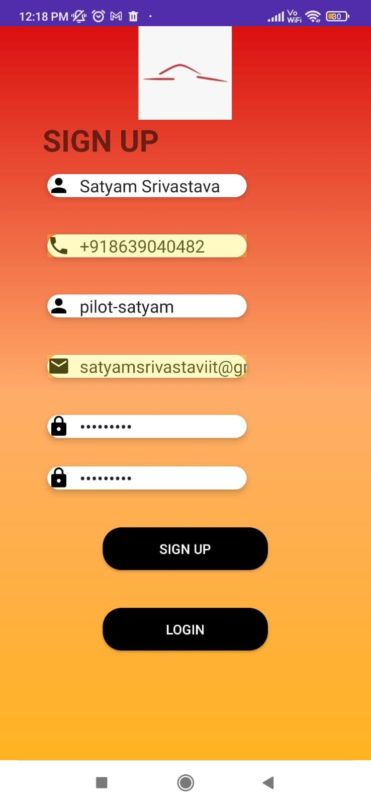
ScReenshots

Slide 20
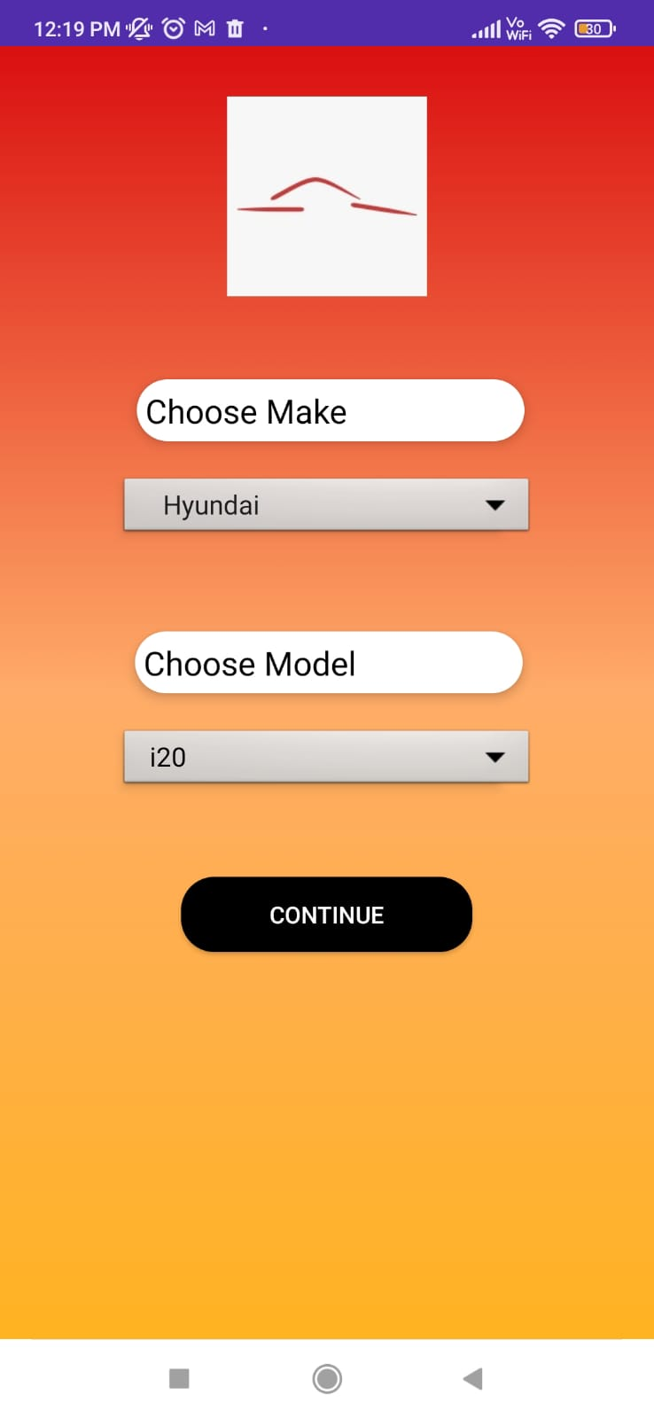
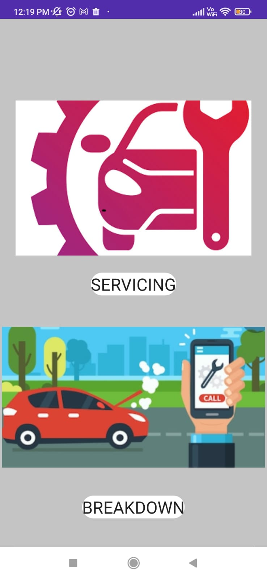

Slide 21
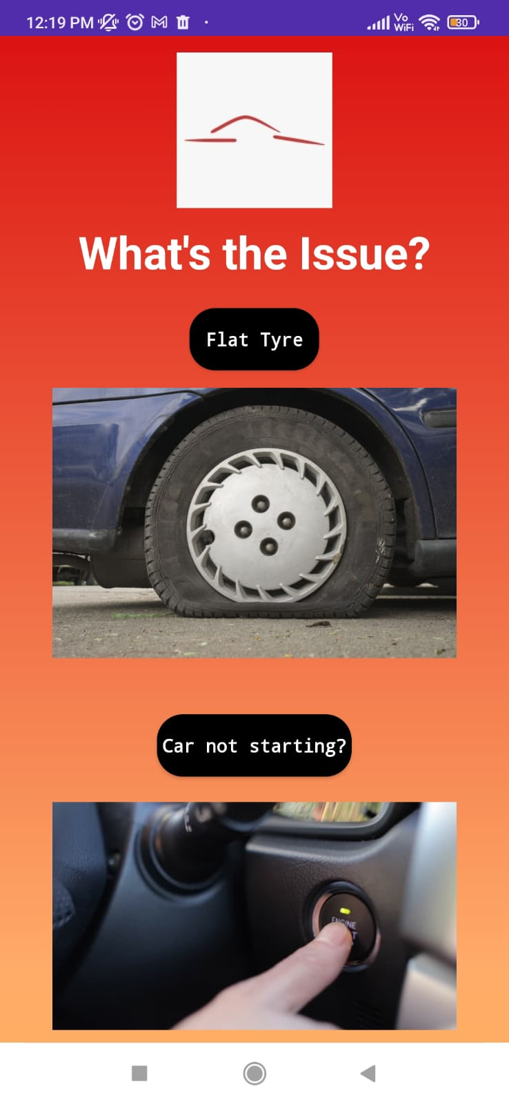
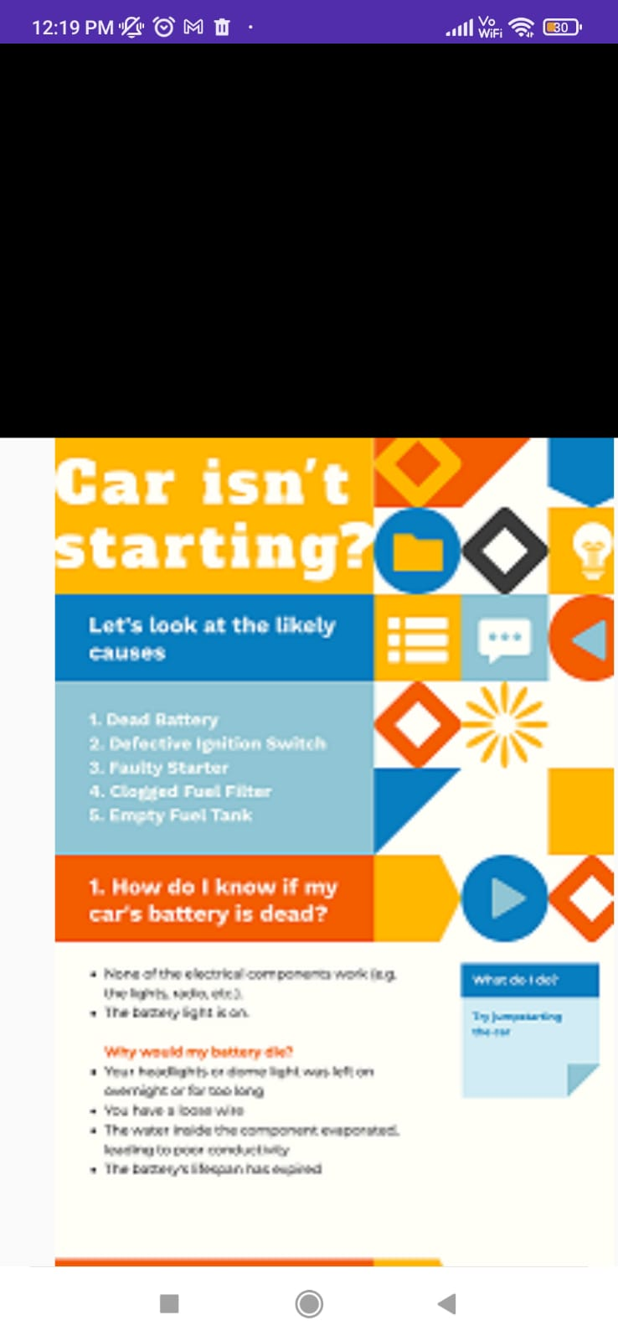
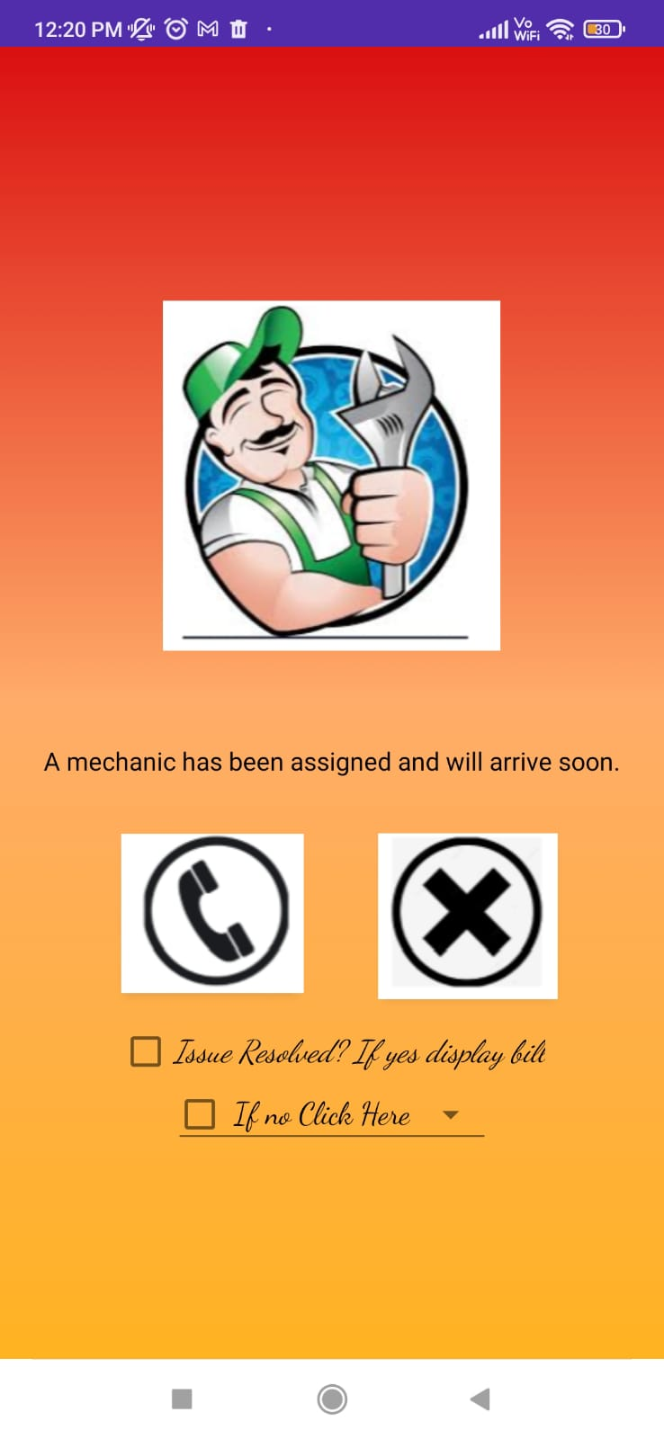

Slide 22
Conclusion
Car(e)Takr is the android application which helps the users to connect with their nearest mechanics depending upon their vehicle issues and also allows them to choose the payment method to the mechanic
It can be either online payment or the payment upon servicing. Users can select the mechanics depending upon their ratings. Car(e)Takr also helps the users in identifying their vehicle problems if they are unfamiliar with it.

Slide 23
ANY QUERIES?

Slide 24
THANK YOU

